Slide 1


第九讲
社会网络分析
主讲教师：朱建明
Email: jmzhu@ucas.ac.cn
Homepage: http://people.gucas.ac.cn/~jianming

Slide 2

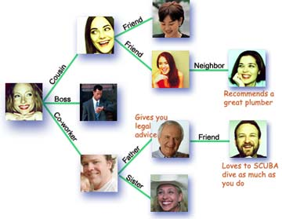
What is Social Network?
Wikipedia Definition:
Social Structure
Nodes: Social actors (individuals or organizations)
Links: Social relations
Notes:
a social structure made of social actors (individuals or organizations) called “nodes”, which are tied by one or more specific Social relations, such as friendship, kinship, religions, knowledge or prestige.
The nodes or actors as part of network data would seem to be pretty straight-forward. Our study mainly focus on the relations among actors.

Slide 3
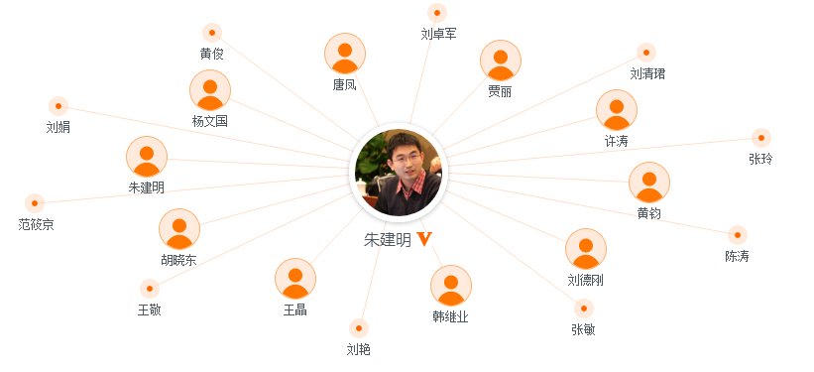
Co-author networks

Slide 4
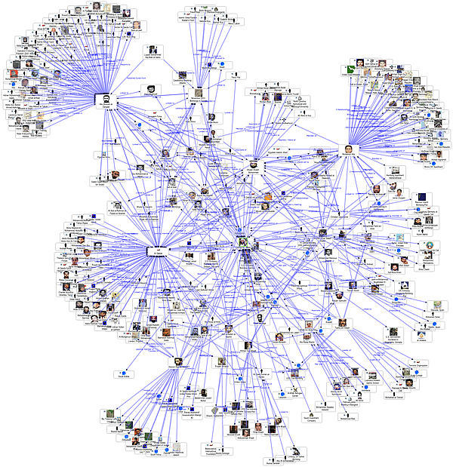

Slide 5
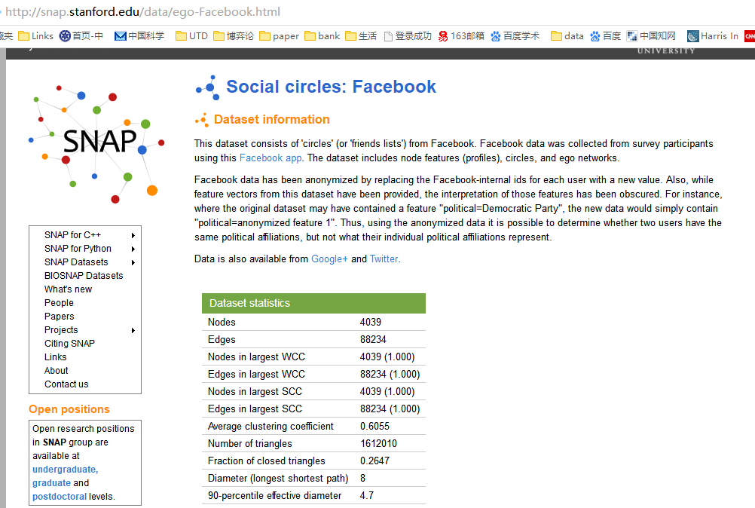

Slide 6
What can we do?
链路预测（最短路径）
关键节点挖掘（寻找权威节点）
网络遍历（搜索与检索）
社区发现（组群画像）
相似节点挖掘（相似性推荐）

Slide 7
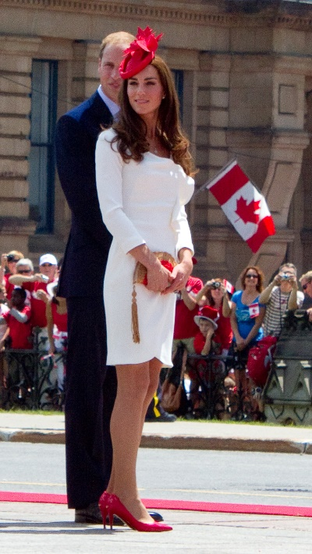

Kate Middleton effect
“Kate Middleton effect
The trend effect that Kate, Duchess of Cambridge has on others, from cosmetic surgery for brides, to sales of coral-colored jeans.”
Notes:
Duchess of Cambridge, Kate, is a fashion icon who leads in fashion circles.
she seems to become more and more beautiful after she married Prince William. Many articles referred her nose as “adorable,” “perky,” and “feminine.”
Women in the New York and Long Island areas are rushing out to seek a plastic surgeon. There are approximately 100 young women a month so far that are requesting cosmetic surgery on their nose to get an exact duplicate of Kate’s.

Slide 8
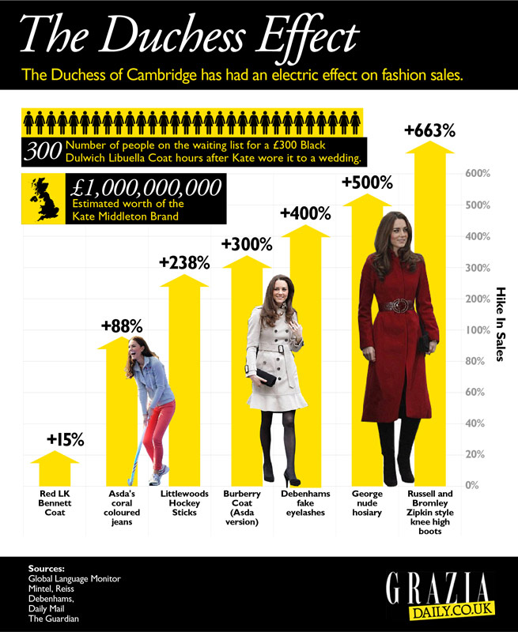
Hike in Sales of Special Products
According to Newsweek, "The Kate Effect may be worth £1 billion to the UK fashion industry."
Tony DiMasso, L. K. Bennett’s US president, stated in 2012, "...when she does wear something, it always seems to go on a waiting list."
Notes:
The fashion choices of the Duchess of Cambridge, Kate Middleton, have already brought $1 billion into the British economy.
Reiss, the High Street store that Kate loves, is planning to open 13 outposts in the U.S. within this year.

Slide 9

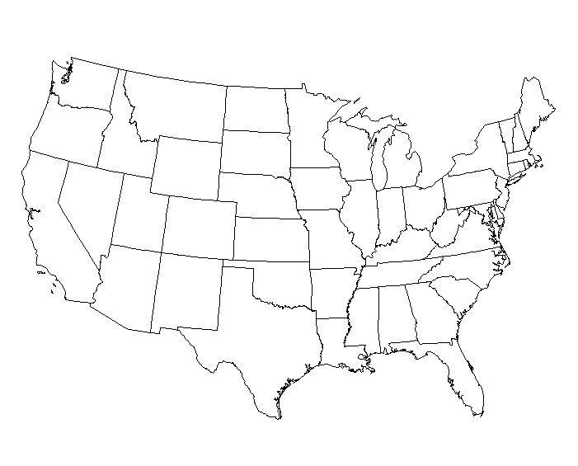


Influence Maximization
A new product is available in the market.
Whom to give free samples to maximize the purchase of the product ?
Notes:
To study the effects of “word of mouth” in the promotion of new products, Domingos and Richardson posed an algorithmic problem in the year 2001.

Slide 10
Seed Selection
A new product is available in the market.
Whom to give free samples to minimize the budget in order to occupy certain market ?
Notes:
To study the effects of “word of mouth” in the promotion of new products, Domingos and Richardson posed an algorithmic problem in the year 2001.

Slide 11
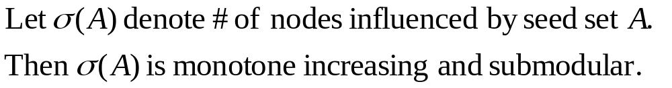

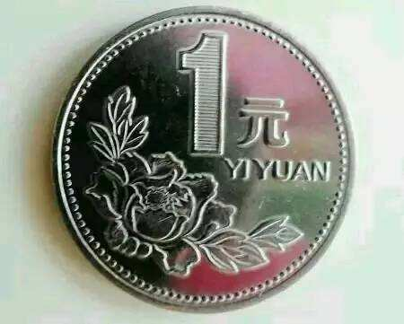
Complexity
NP-hard
#P-hard
随机算法

Slide 12
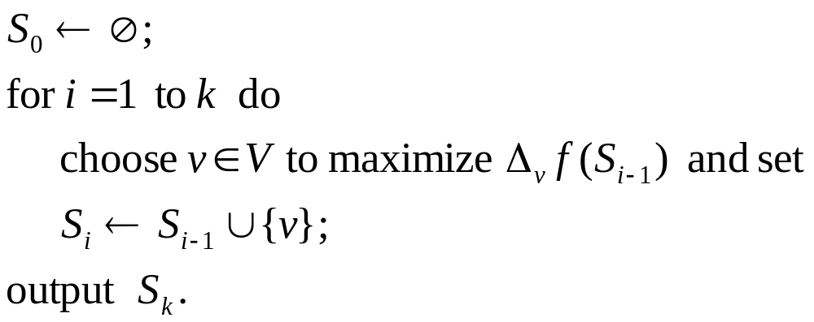
Algorithm - Greedy

Slide 13
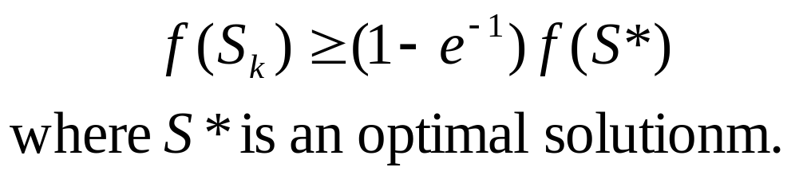
results

Slide 14


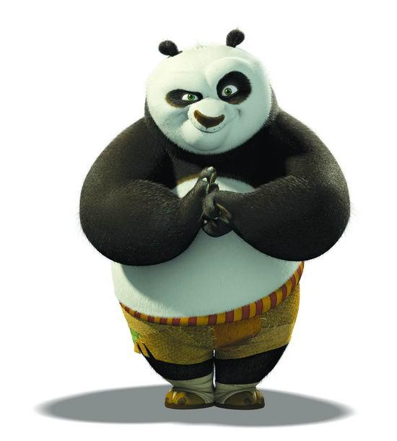
Thanks

